Slide 1

INTRODUCING
~a one-stop solution to all your medical problems
01

Slide 2
Good health is not something we can buy. However, it can be an extremely valuable savings account..
-ANNE WILSON SCHAEF
The goal of real healthcare reform must be high-quality, universal coverage in a cost-effective way.
-BERNIE SANDERS

Slide 3

An all-in-one software that helps
You find hospitals best suited for you based on availability
Live vitals-tracking
Storage of medical records
An in-built SOS button incase of emergencies
ClickCare

Slide 4
Needs and Current Impact
There have been many cases where a patient has not been able to adequate healthcare because they wasted time in travelling to a hospital which did not have beds available or the required doctor; thus losing significant time

Slide 5
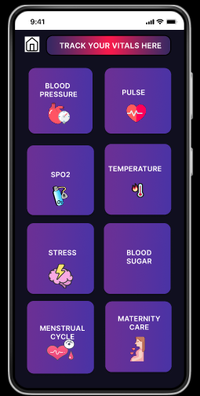
Development and Approach
Building an all-in-one software that helps in
Live tracking of the vitals of the patient
Mapping the patient to a number of hospitals and direct them to one based on reviews and availability of bed and adequate healthcare professional
Storing the medical data of the patient
Issuing notices for check-up
The software also has an in-built SOS button in case of emergencies
UI framework has been done, the basic framework of the software has been decided

Slide 6
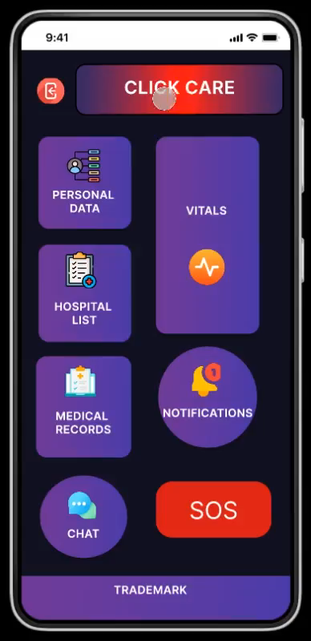
Uniqueness of the idea
While live tracking of vitals is not unique, inferring a conclusion and thus alerting the patient and the hospital, by mapping the two, we plan on issuing an SOS button that alerts the patient if they need a consultation, based on the availability of the hospital (the software connects to the next mapped hospital in the database)

Slide 7
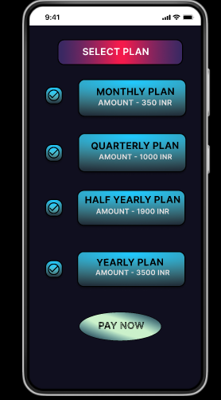
Users from all age groups, with specialized services for the elderly, pregnant women, etc.
Proposed price point:
Rs. 350 (monthly)
Rs. 1000(quarterly)
Rs. 1900(half-yearly)
Rs. 3500(yearly)
All the available solutions provide a maximum of 1-2 of the features we offer, we also map all the available govt-led and private hospitals, providing the user with all available cost options.
Business
model

Slide 8
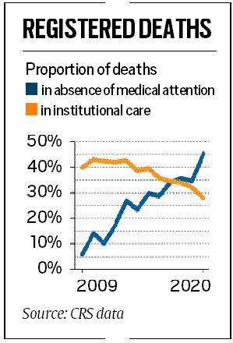
Impact
Thousands of people losing precious time getting to different hospitals without knowing the availability there, many stories to get evidence from -> the solution we propose eliminates that
It helps bridge the gap between concluding results from the live tracking from wearable devices nowadays and hospitals

Slide 9
Scalability and Adaptability
Anyone with a smartphone will be able to access the software and make use of it
With more growth and demand, we will be able to include a wider range of hospitals in our database
With expanding technology in rural areas, the app can help digitalize and organize the rural hospitals and make them more accessible to the rural public

Slide 10
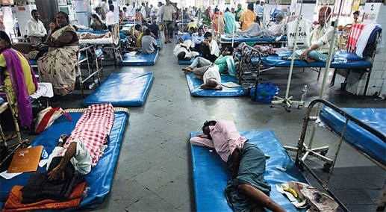
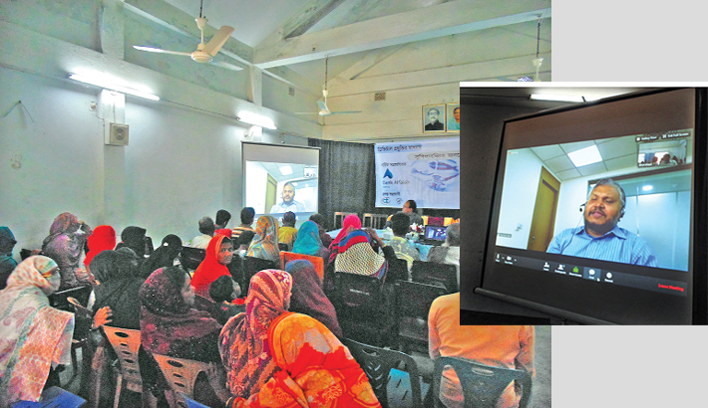
Potential roadblocks and Solutions
Vital tracking may not be 100% accurate
Patient-hospital mapping may not be efficient
Hospital infrastructural constraints
With gradual scalability of our proposed solution, we can partner with multiple governments as well as private initiatives in turn addressing the present constraints.
Rural expansion of our app would allow the regressive society to digitalize medical system along with the rest of India.

Slide 11


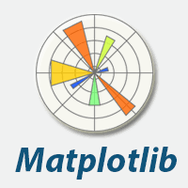


TECH STACKS
Machine Learning Model (Vitals)
Azure (Cloud Storage)
Matplot Lib (Graph)
Flutter
Figma

Slide 12
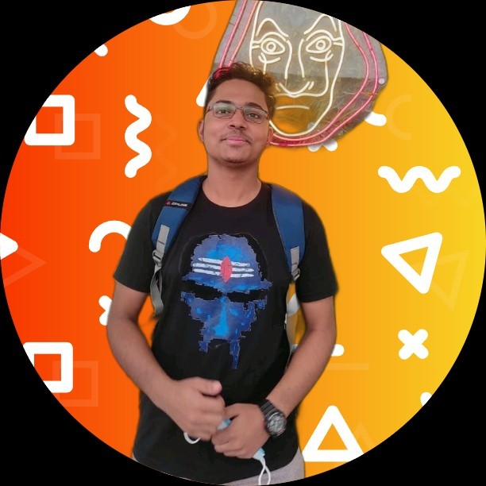


Team Members
MAINAK
CHATTOPADHYAY
SRIJENA
GUIN
PARTHIBA
MUKHOPADHYAY

